Slide 1
Data visualization and github & reproducibility
Andrew Wilson, Phd, Mstat
Adjunct Asst Prof & Day job at Parexel

Slide 2
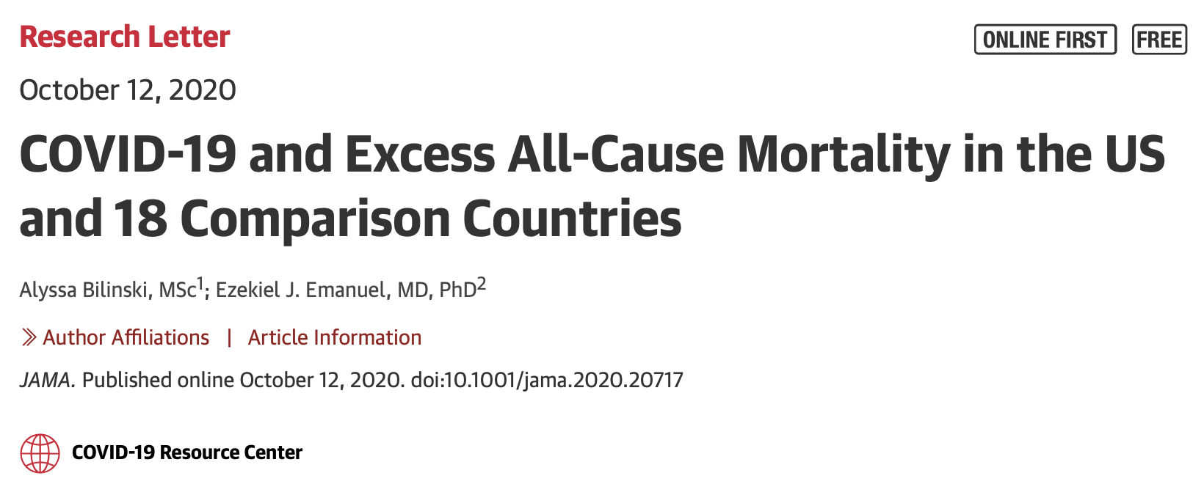

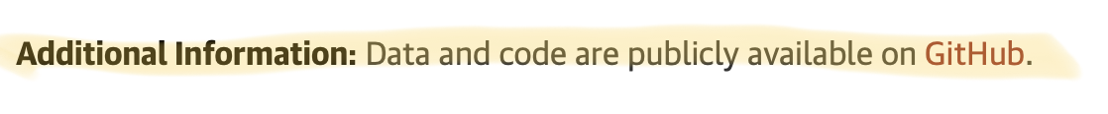
Agenda
How is everyone?
Introduction to some data visualization.
How to look under the hood of some publications: GITHUB.

Slide 3
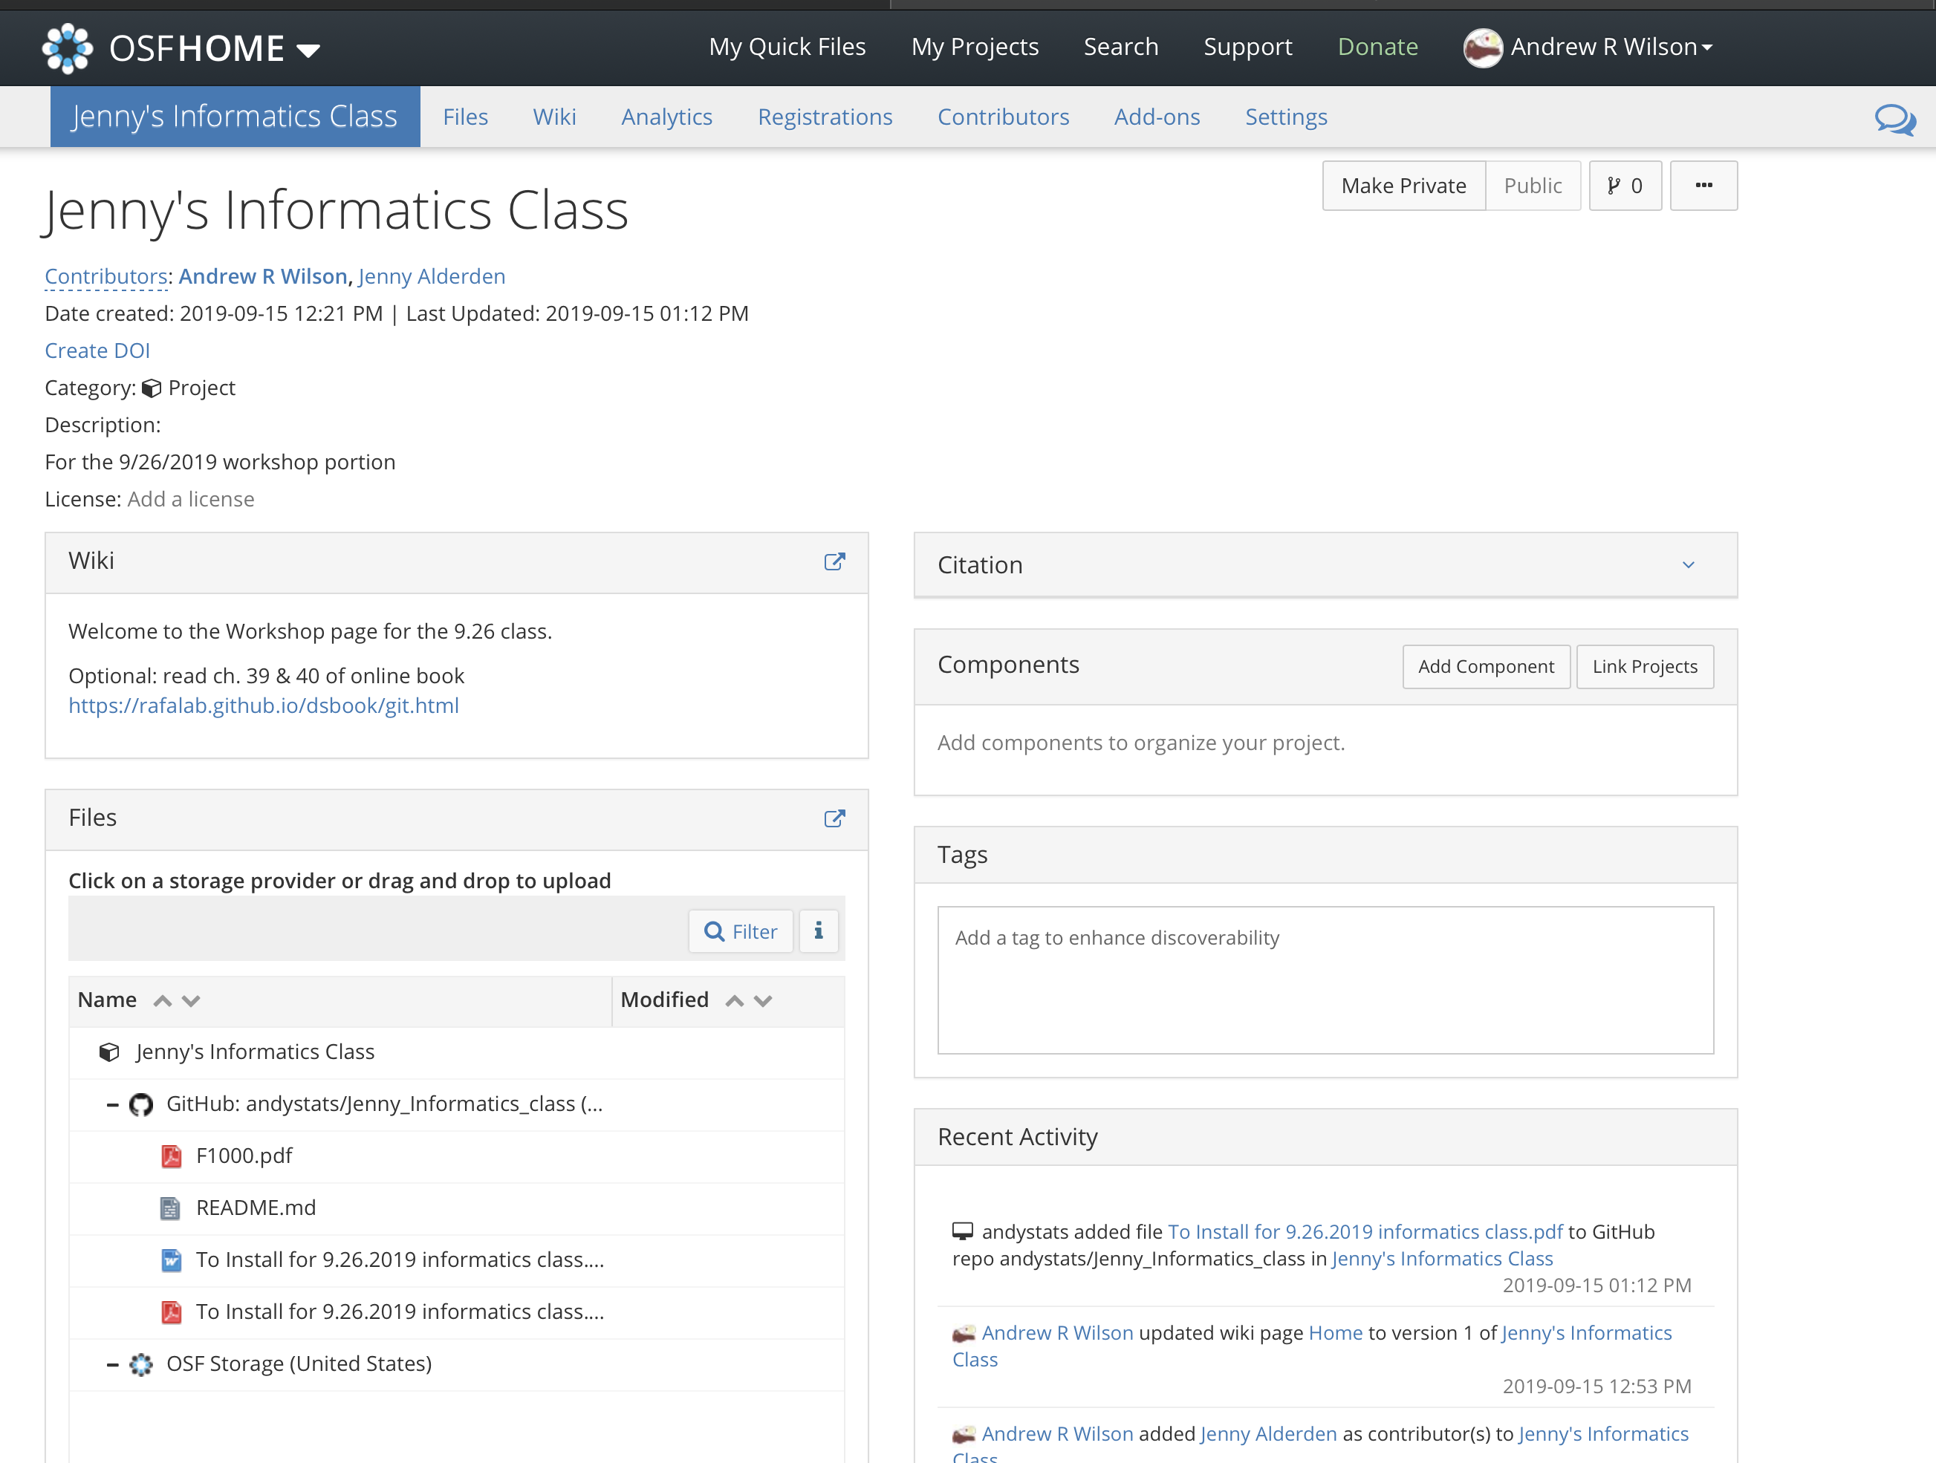
Everything’s updated on the OSF page

Slide 4
Data Viz

Slide 5
Two totally disparate examples
Time series (COVID by US state):
Sankey plots:
Patient journeys

